Slide 1

Research Question – Is there a correlation between population size and violent crime rate in the United States? Date: 22-11-2024
Group Name: A303 Name of Student Presenting: IQBAL UD DIN

Slide 2
Dataset Overview Dataset Name: U.S. Crime Statistics Dataset Variables: Independent Variable: Population (Interval) Dependent Variable: Violent Crime Rate (Interval)
Dataset ID: 285 (Crimes dataset.csv)
Notes:
Before specifying your Research Question you must define the type of data you are analysing. Are the variables you select interval data (measurement data you can divide, multiple, etc), OR are they ordinal (there is a definite order but the intervals between each variable are not necessarily equal, or the terms might be subjective like in a likert scale); OR are they just categorical/nominal (Items such as film names, cities, etc., that you can count numbers of occurrences? You also need to understand whether the variable is either dependent or independent and this will vary according to the context. Independent variables may cause an effect, whereas the dependent variable might be effected by the independent variable. Check the lecture notes on the RQ for more information and examples.
You will get only one opportunity to present your Research Question ahead of the submission date. Have your questions ready, and be ready to take notes on feedback.

Slide 3
Independent Variable: Population (Interval Data) Definition: Total number of people residing in the U.S. each year. Rationale: Population size may influence the rate of crimes due to various socioeconomic and demographic factors. Dependent Variable: Violent Crime Rate (Interval Data) Definition: Number of violent crimes per 100,000 inhabitants annually. Rationale: Indicates the prevalence of violence, reflecting potential societal impacts of population dynamics.
Variables
Notes:
Before specifying your Research Question you must define the type of data you are analysing. Are the variables you select interval data (measurement data you can divide, multiple, etc), OR are they ordinal (there is a definite order but the intervals between each variable are not necessarily equal, or the terms might be subjective like in a likert scale); OR are they just categorical/nominal (Items such as film names, cities, etc., that you can count numbers of occurrences? You also need to understand whether the variable is either dependent or independent and this will vary according to the context. Independent variables may cause an effect, whereas the dependent variable might be effected by the independent variable. Check the lecture notes on the RQ for more information and examples.
You will get only one opportunity to present your Research Question ahead of the submission date. Have your questions ready, and be ready to take notes on feedback.

Slide 4
Null Hypothesis (H₀): There is no correlation between population size and violent crime rate in the United States. Alternative Hypothesis (H₁): There is a correlation between population size and violent crime rate in the United States.
Our Hypothesis are

Slide 5
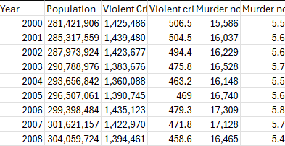
Snippet of Dataset

Slide 6
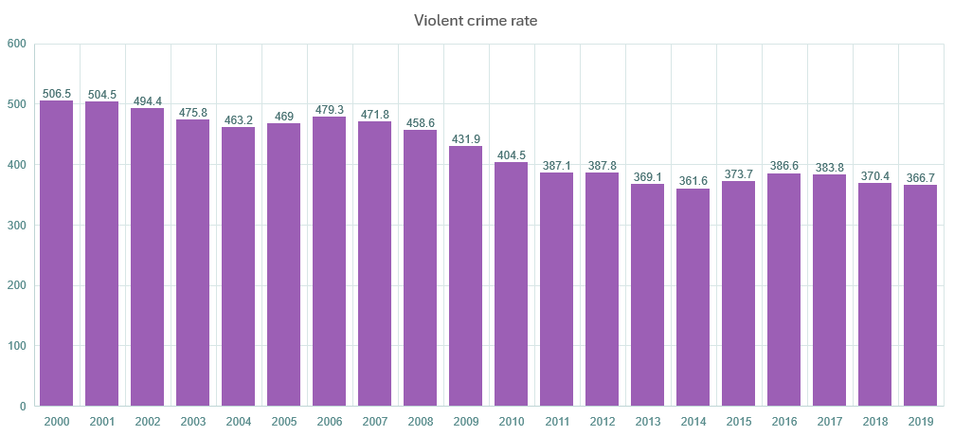
Violent Crime Rate Over the Year

Slide 7
Crime Rate Over Population

